Slide 1

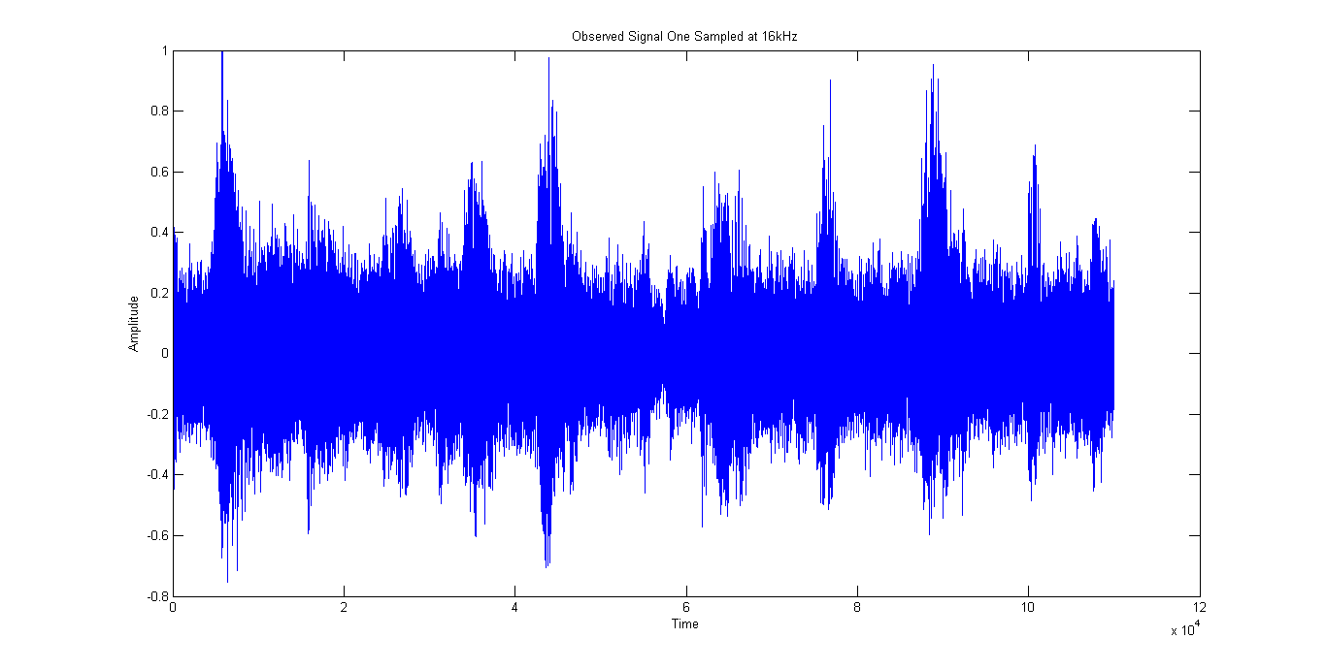
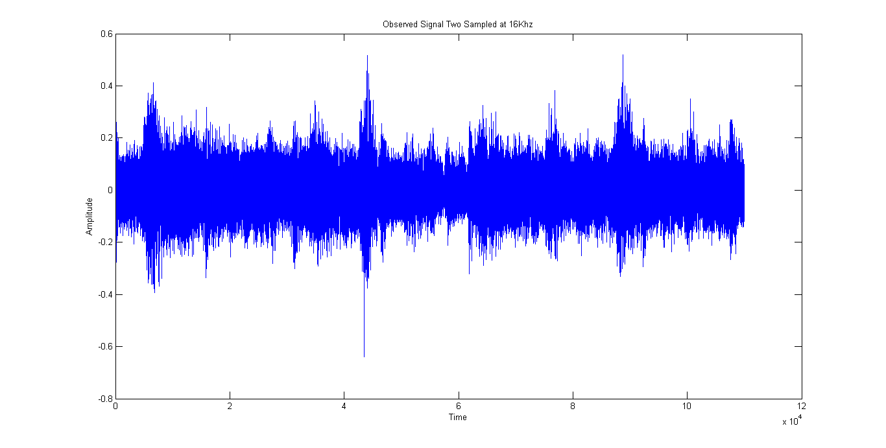

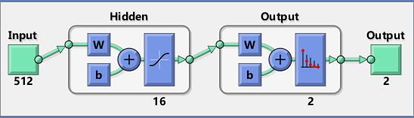
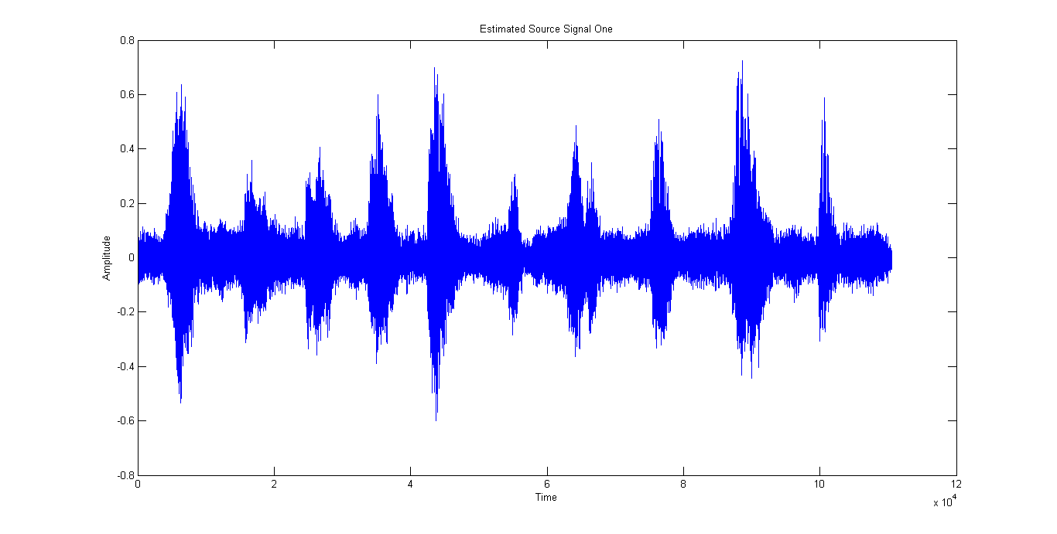
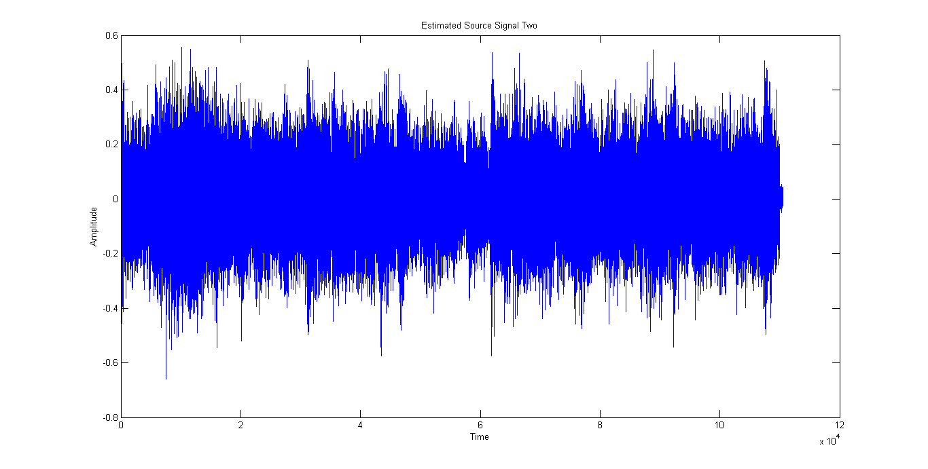
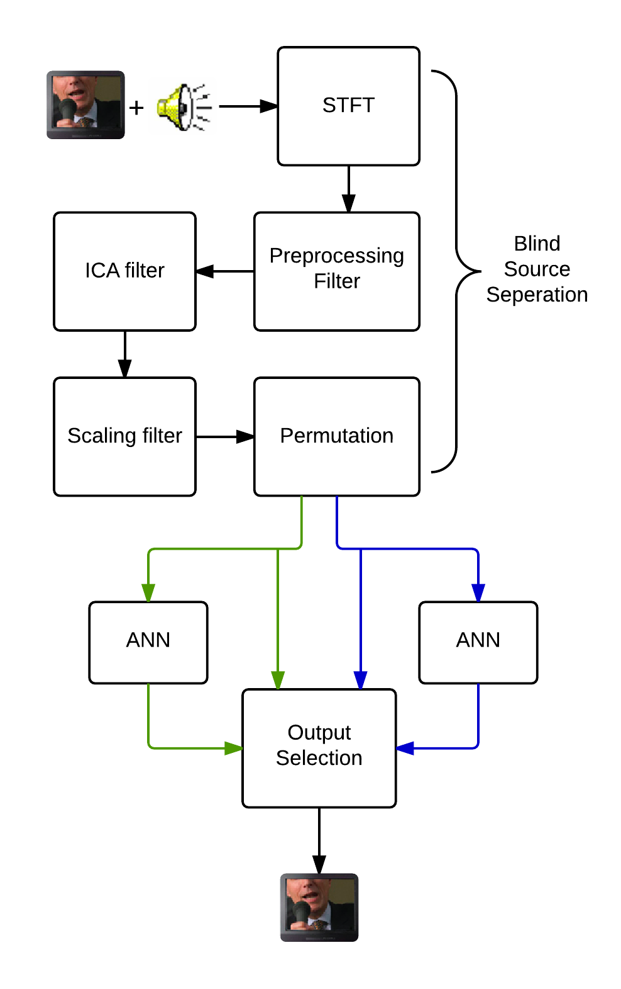
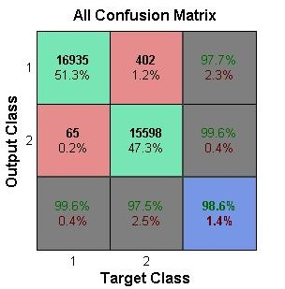
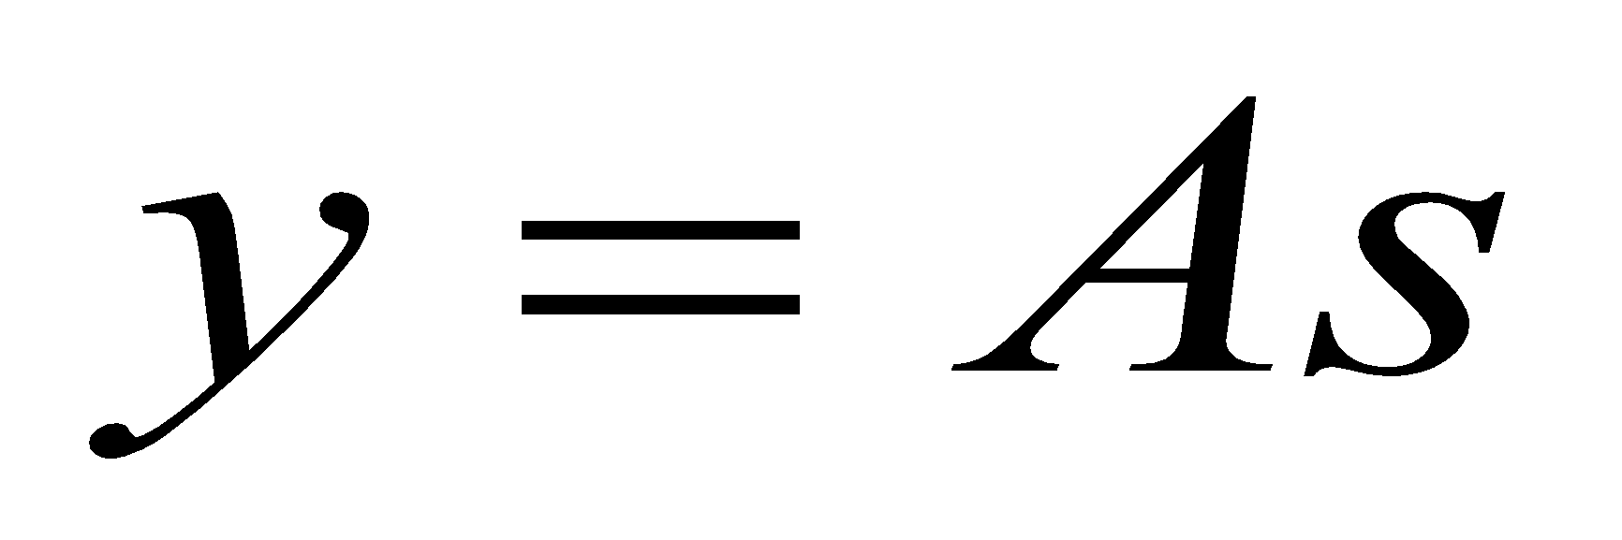
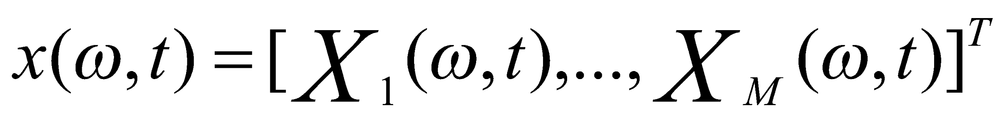
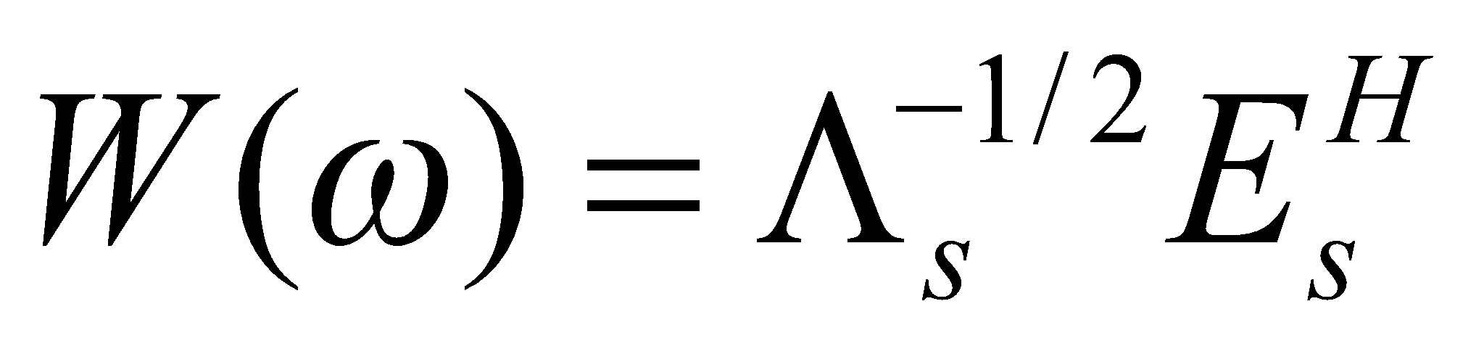

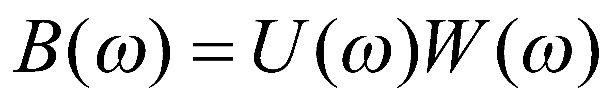
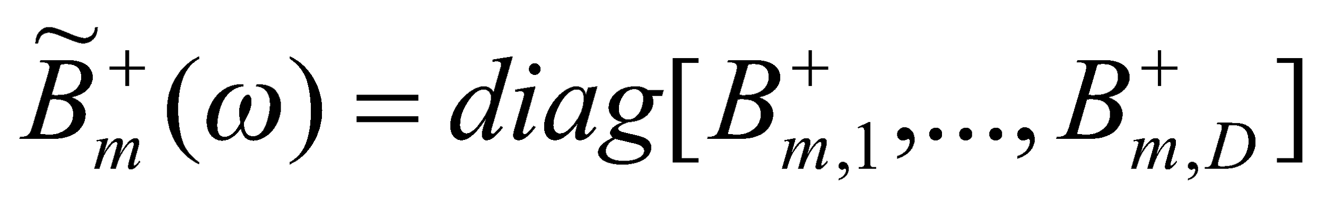
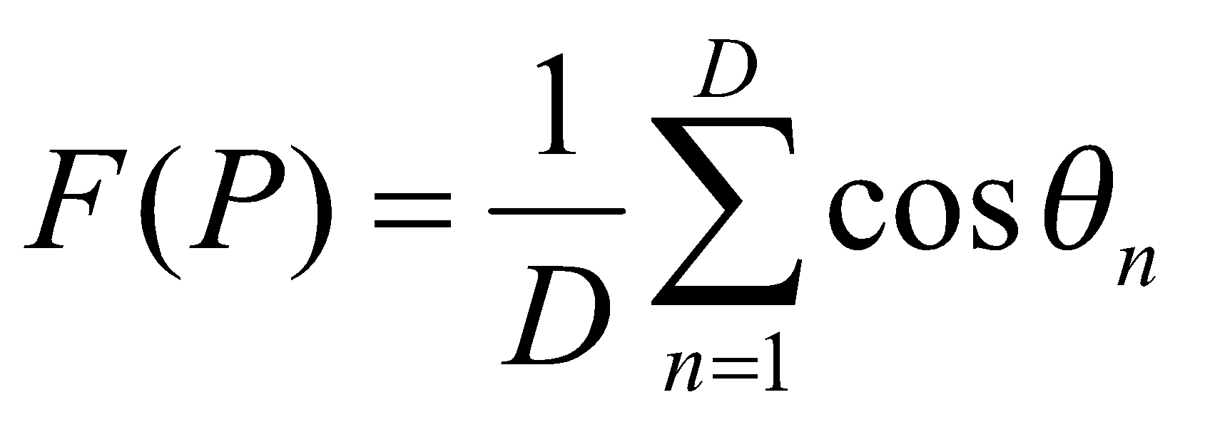
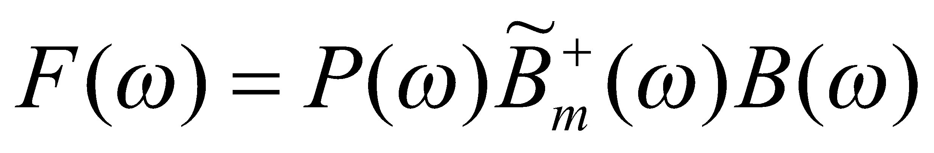
Wireless Neural Recorder Yuan Gao, Tingkai Liu, Xin Huang, Stephen Xia
Rice University Department of Electrical and Computer Engineering
Objective
Neural Network
Results
We used a three-layer neural network to distinguish between human speech and background noise.
More specifically, our neural network consists of an input layer, a hidden layer, and an output layer and uses the backpropagation algorithm and gradient descent to minimize the cost function.
Project Overview
Figure 1: Mixed signal observed at 1st microphone
Figure 2: Mixed signal observed at 2nd microphone
Since our objective is to blindly separate an input signal into its principal/independent components, we will use independent component analysis to separate the signal into its components.
Then, we will utilize a neural network to select which output signal, if any, contains human speech, and forward it to the output.
Independent Component Analysis
System Block Diagram
Figure 3: Estimate source signal one – human speech
Figure 4: Estimated source signal two – music
Problem formulation:
y = input signals (sound mixtures)
s = original sources
ICA attempts to find the independent sources (individual sounds) that comprise an input signal by solving the following formulation for A⁻¹
A is the mixing matrix used to combine the original sources, s, to obtain the observed input signals, y.
 | Parameters
Sampling Rate | 16 kHz
Length of STFT | 512
Number of FFT Points | 4096
Overlap | 492
Number of inputs | 2
Permutation Reference Range | 5
BSS separates input signal into two components.
Neural network places a weight on each output based on how much human speech they contain.
The system outputs the signal with the highest weight above a threshold.
Blind Source Separation (BSS)
Figure 5: Accuracy of neural network
Figure 6: Input parameters into the system.
Conclusion and Future Steps
Transform M microphone inputs into frequency domain by taking the short-time Fourier transform (STFT).
Find subspace filter to reduce reflections and ambient sound.
Find ICA filter matrix, , for all sampled frequencies.
Separation filter:
Scaling filter:
Permutation filter:
Final filter:
Figures 3 and 4 show that our BSS method is able to separate an input signal into two independent and distinct sources.
Our neural network can perform binary classification with 98.6% accuracy.
Implementation in real-time.
Explore possibility to separate sources from more than two inputs.
Acknowledgements
Hyvärinen, Aapo, and Erkki Oja. "Independent component analysis: algorithms and applications." Neural networks 13.4 (2000): 411-430.
Asano, Futoshi, et al. "Combined approach of array processing and independent component analysis for blind separation of acoustic signals."Speech and Audio Processing, IEEE Transactions on 11.3 (2003): 204-215.
Special thanks to Professor Richard Baraniuk and Dr. Mohammad Golbabaee.
For questions, please contact:
Zichao.Wang@rice.edu; Tianyi.Yao@rice.edu; Stephen.Xia@rice.edu; Shengjia.Zhao@rice.edu

